Slide 1


Partnerships in Education & BOSS
(PIE BOSS)
An Enterprise Europe Initiative
Ruth Ploeger IMCOM Europe School Liaison Officer ruth.c.ploeger.naf@mail.mil DSN 314-544-9375

Slide 2

Fast Facts:
The average military child will experience six to nine transitions during his/her K-12 school years.
Providing a good education for the children of service members is one of the quality of life issues that can affect military retention.
Ruth Ploeger IMCOM Europe School Liaison Officer ruth.c.ploeger.naf@mail.mil DSN 314-544-9375

Slide 3
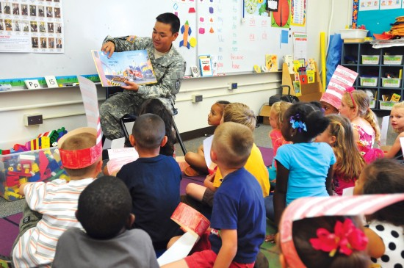
Partnerships in Education (PIE) creates a volunteer network of resources, installation and community members who have a vested interest in the educational success of military connected youth.
Ruth Ploeger IMCOM Europe School Liaison Officer ruth.c.ploeger.naf@mail.mil DSN 314-544-9375

Slide 4
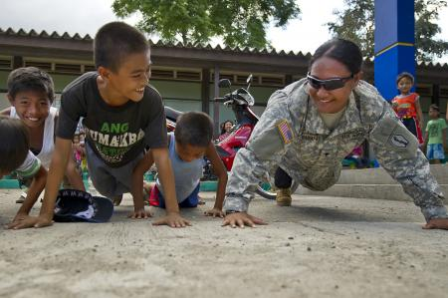
PARTNERSHIPS IN EDUCATION
A major component of PIE is the connection between schools and military volunteers.
Adopt-A-School program in which units “adopt” schools and form a regular support relationship with a school is part of that component.
Ruth Ploeger IMCOM Europe School Liaison Officer ruth.c.ploeger.naf@mail.mil DSN 314-544-9375

Slide 5
PIE – Participation Benefits
Schools/ Military Kids
Army
Aids positive perception of military by the community
Esprit de Corps / Morale
Improves chances that students may one day choose a military career
Provides evidence of the Army’s commitment to the education of dependent children to Army Families.
Provides opportunities for soldiers to practice briefing and public speaking
Positive impact on retention
Receive increased academic support and assistance / improve performance
Encounter new perspectives
Instill greater pride in what their parents do
Receive increased emotional support by having another adult who cares
Free up schools/educators to focus more energy on direct instruction
Ruth Ploeger IMCOM Europe School Liaison Officer ruth.c.ploeger.naf@mail.mil DSN 314-544-9375

Slide 6

Categories of support
Lunch/
Recess buddy
Tutoring/ Reading Support
Logistical Support
Guest Speaker
School Events
Ruth Ploeger IMCOM Europe School Liaison Officer ruth.c.ploeger.naf@mail.mil DSN 314-544-9375

Slide 7
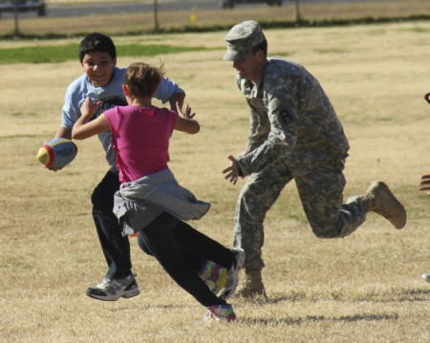
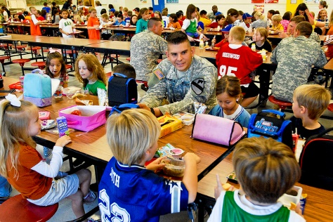
Sometimes military children may be dealing with sadness due to a PCS move or concern over a parent being deployed or injured. Having an adult they can chat with or even just have fun with (especially one that is clearly from the military), can positively impact the emotional well being of the child. It need not be “psych session”. Just having some extra attention paid to them can truly bring light to a child’s day and make school a more fun place. Sometimes the cafeteria or playground can be an unfriendly place. You can counter that. It’s simple! And you might actually have fun doing it!
Lunch/
Recess buddy
Ruth Ploeger IMCOM Europe School Liaison Officer ruth.c.ploeger.naf@mail.mil DSN 314-544-9375

Slide 8
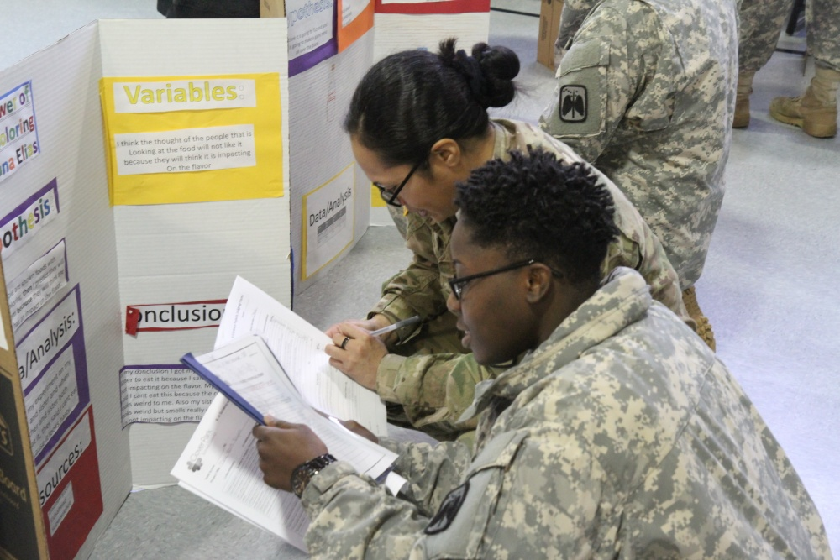
School Events
Science Fairs
Field Days
School Carnivals
STEM Day
Assemblies
Brain Bowls
Ruth Ploeger IMCOM Europe School Liaison Officer ruth.c.ploeger.naf@mail.mil DSN 314-544-9375

Slide 9
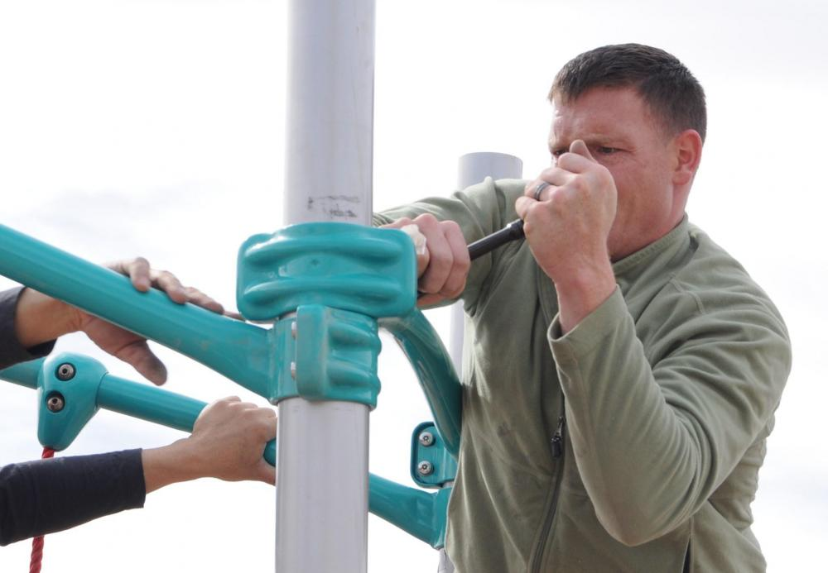
Logistical Support
Painting a mural
Assisting with assembly of new furniture
Moving desks/books
Buddy Bench etc. / special project
Bulletin boards / materials
Should NOT include providing what is covered by “regular maintenance or under contract.” i.e. cutting grass every week.
Posse Comitatus Act must be observed. Soldiers cannot provide police security type support in off base schools per this law.
Ruth Ploeger IMCOM Europe School Liaison Officer ruth.c.ploeger.naf@mail.mil DSN 314-544-9375

Slide 10
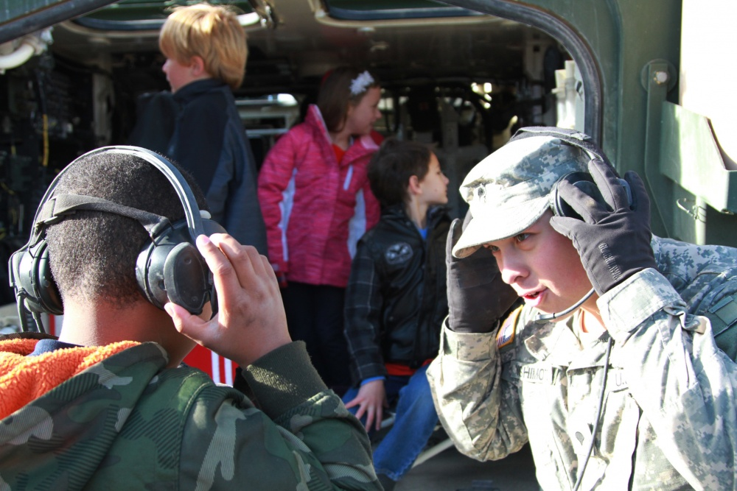
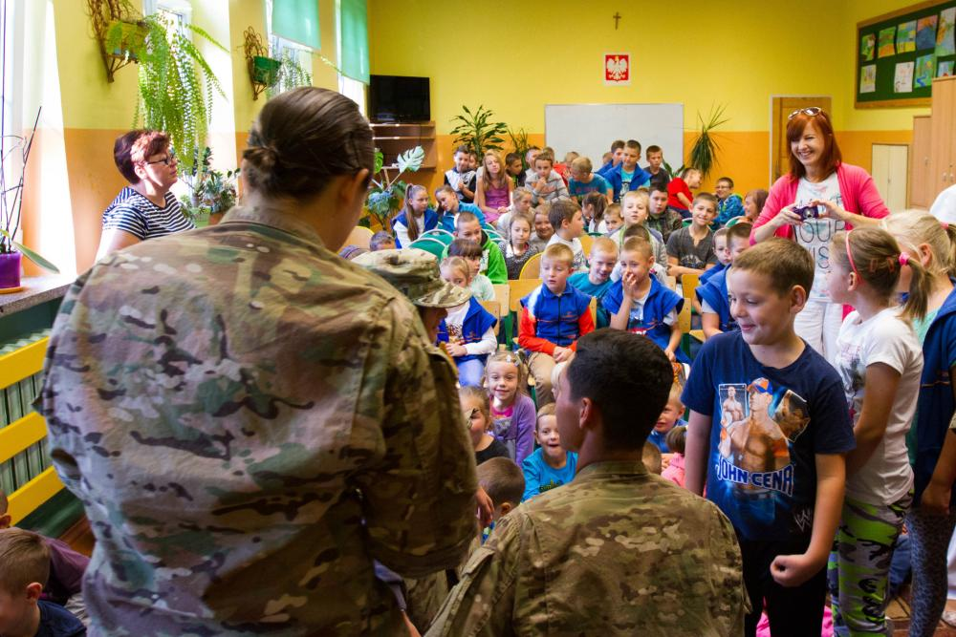
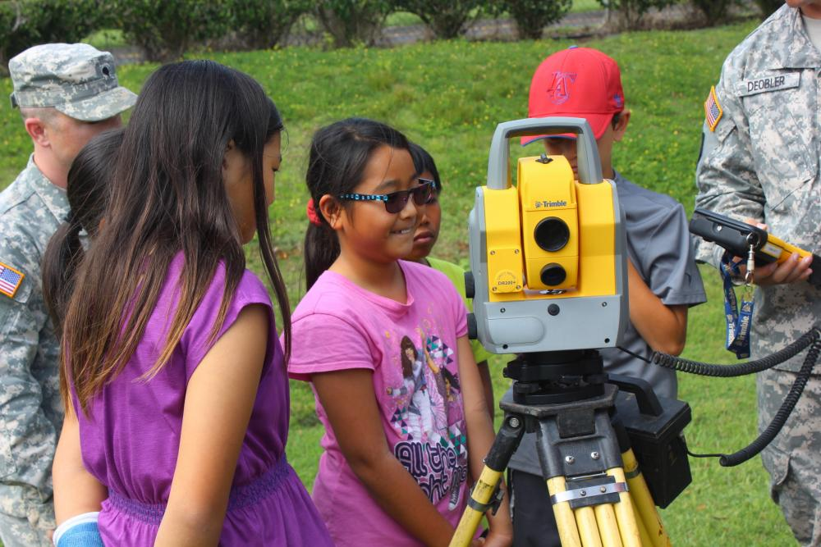
Guest Speaker
Speak about a topic you are familiar with or within your expertise
Share a talent or experience
Speak on a school requested topic (i.e. What MLK Day Means to you)
Present an activity or “hands - on” experience
Can be in the classroom or outside the classroom
Can be a “station” type activity you have designed in which multiple soldiers guide children in an activity or learning experience.
Ruth Ploeger IMCOM Europe School Liaison Officer ruth.c.ploeger.naf@mail.mil DSN 314-544-9375

Slide 11

Tutoring/ Reading Support
Elementary Level support to “listen” to early/struggling readers as they practice reading aloud.
Read a story to a class.
Assist in library literacy programs
Tutoring students in any of the various subjects. (Strong need for math, science, and reading support.)
Ruth Ploeger IMCOM Europe School Liaison Officer ruth.c.ploeger.naf@mail.mil DSN 314-544-9375

Slide 12

Prescreening forms: (on website)
1. DD2793
2. DD2981
--------------------------------------------
3. FBI Fingerprints
4. Installation Records Check (IRC)
Includes checks with:
a. Army Law Enforcement (ALE)
b. Army Central Registry (ACR) for the Family Advocacy Program
c. Army Substance Abuse Program (Includes: MEDCOM Clinical Check & IMCOM Check)
BACKGROUND CHECKS
Your school can assist you with your local school’s requirements. Your background check is good at all DoDEA Schools. For local national schools you will need to follow through on their local requirements. Consult your military host nation liaison for guidance.

Slide 13

DO’s for school volunteering
DO
take a personal interest in helping and working with teachers, staff and students.
be willing to learn more about fostering the process of growth and development in children.
be willing and able to follow directions from teachers and staff.
be adaptable and flexible when working with children.
have a cooperative attitude in working with school personnel.
be imaginative, creative and optimistic.
be consistent and dependable.
keep all student information strictly confidential.
have a sense of humor as well a patience and understanding.
accept each child for who they are.
let the teacher be responsible for discipline.
Be willing to share your skills, talents, and knowledge.
Ruth Ploeger IMCOM Europe School Liaison Officer ruth.c.ploeger.naf@mail.mil DSN 314-544-9375

Slide 14

DON’Ts for school volunteering
DON’T
forget to sign in and out of the office every time you’re in the building.
scold when pointing out errors. Use a positive approach.
become annoyed when students don’t understand something the first time.
be afraid to laugh at yourself.
lose your temper.
do a student’s work for them.
discuss student’s work with anyone but the teacher.
ask teachers or others for personal information about students.
threaten or punish students.
intervene or contradict a teacher once a problem has been handled.
forget to contact the teacher or school if you can’t fulfill your commitment.
bring illness to the classroom.
forget that you are a role model.
Ruth Ploeger IMCOM Europe School Liaison Officer ruth.c.ploeger.naf@mail.mil DSN 314-544-9375

Slide 15

Possible Challenges
Special Needs Students
Emotional/Behavior problems
Close in age students
Student’s parent deployed, injured, or fallen
Observing or becoming aware of child abuse/neglect
Duty station with no US schools
Ruth Ploeger IMCOM Europe School Liaison Officer ruth.c.ploeger.naf@mail.mil DSN 314-544-9375

Slide 16
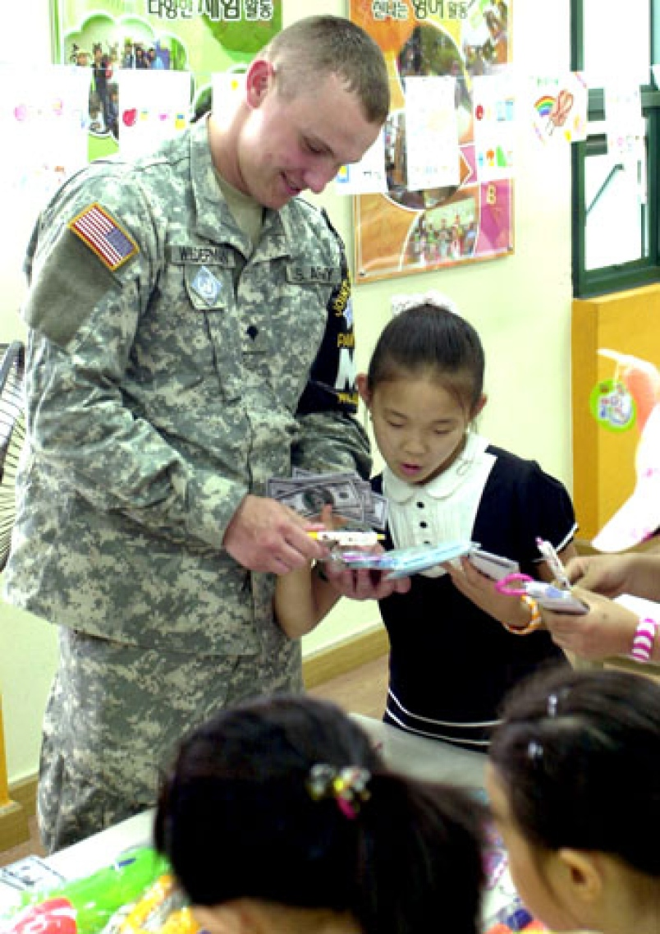
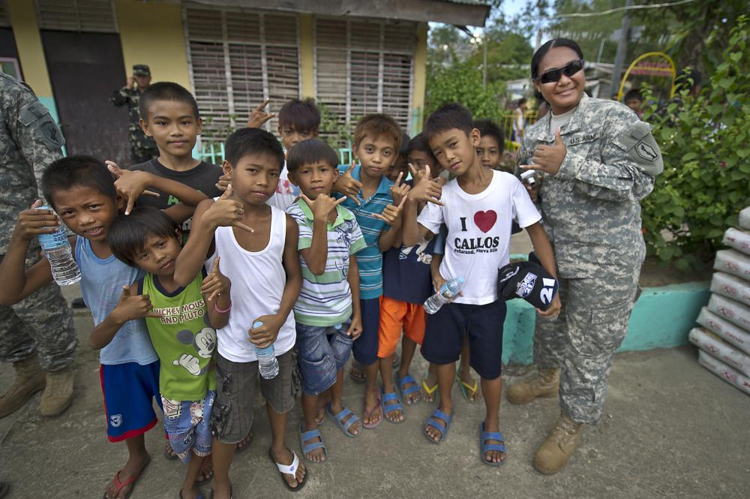
OCONUS Locations with No American Schools
Volunteering at a Non-American school in duty locations without one is okay, but must not conflict with command guidance.
Contact your command’s liaison to the local community for more assistance in connecting with a school.
Safety and OPSEC are primary considerations when volunteering in locations without US schools.
Ruth Ploeger IMCOM Europe School Liaison Officer ruth.c.ploeger.naf@mail.mil DSN 314-544-9375

Slide 17

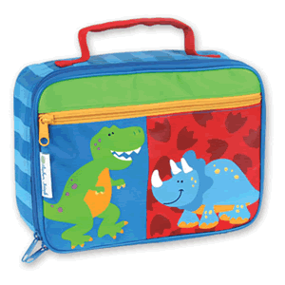




Limited volunteer opportunities may also be available with Child and Youth Services (CYS) Programs.
Please contact the SLO for more information.
Child Development
Centers
School-Age Centers
Youth Sports
& Fitness
Youth Centers
(Middle School
-Teen Centers)
Instructional Classes
(SKIESUnlimited)

Slide 18
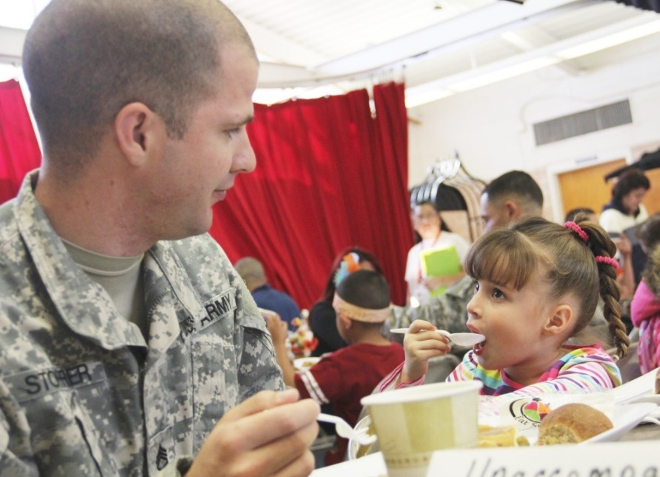
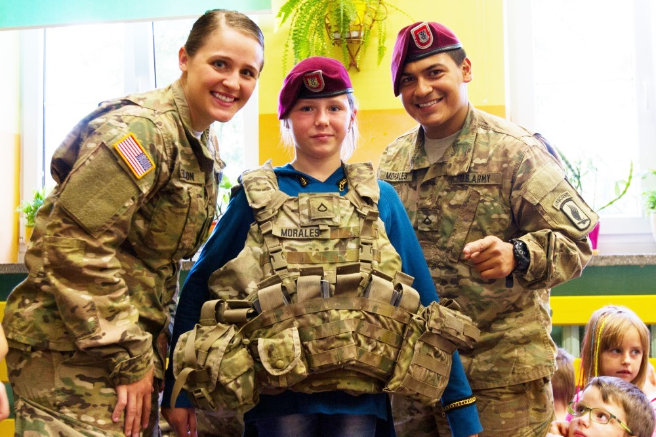
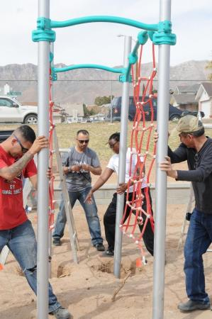
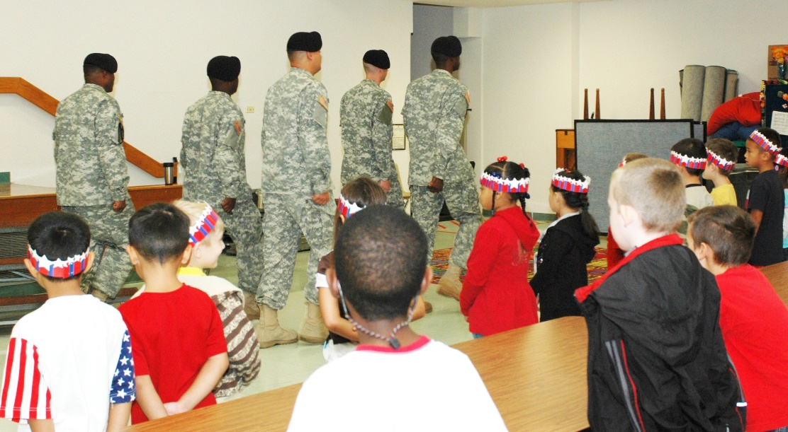
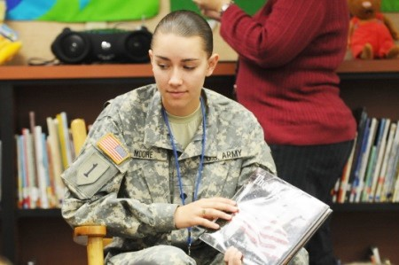
PIE / BOSS
Lunch/
Recess buddy
Guest Speaker
Guest Speaker
Tutoring/ Reading Support
School Events
Logistical Support
Ruth Ploeger IMCOM Europe School Liaison Officer ruth.c.ploeger.naf@mail.mil DSN 314-544-9375

Slide 19

School Liaison Officers’ Core Services:
1. School Transition Services (PCS Cycle) & Deployment Support
2. Installation, School, and Community Communications
3. Partnerships in Education (PIE)
4. Home School Linkage and Support
5. Post-Secondary Preparation
Ruth Ploeger IMCOM Europe School Liaison Officer ruth.c.ploeger.naf@mail.mil DSN 314-544-9375

Slide 20

What a
School Liaison Officer is NOT:
Not a school employee
Not a police officer
Not a school superintendent
Not a doctor
Not a lawyer
Not a Service Member
Ruth Ploeger IMCOM Europe School Liaison Officer ruth.c.ploeger.naf@mail.mil DSN 314-544-9375

Slide 21


What does the School Liaison Officer position fall under?
Garrison
Morale Welfare and Recreation (MWR)
Child & Youth Services
(CYS)
School Support Services
School Liaison Officers
(SLOs)
Ruth Ploeger IMCOM Europe School Liaison Officer ruth.c.ploeger.naf@mail.mil DSN 314-544-9375

Slide 22

How Do I Find A
School Liaison Officer?
Europe.armymwr.com/slo
Ruth Ploeger IMCOM Europe School Liaison Officer ruth.c.ploeger.naf@mail.mil DSN 314-544-9375

Slide 23

VISION:
Every service member interested in a career in in teaching will receive assistance to transition his or her leadership, training, and core values to teaching in Kindergarten through grade twelve schools.
MISSION:
Assist transitioning Service Members with meeting the requirements necessary to become teachers
Assist program participants with finding employment as a teacher when eligible
www.proudtoserveagain.com
GOALS:
Reduce veteran unemployment
Improve American education by providing motivated, experiences and dedicated personnel for the nation’s classrooms
Increase the number of male and minority teachers in today’s classrooms
Address teacher shortage issues in K-12 schools that service low-income families and in the critical subjects- math, science, special education, foreign language, and career-technical education.
Ruth Ploeger IMCOM Europe School Liaison Officer ruth.c.ploeger.naf@mail.mil DSN 314-544-9375

Slide 24


Troops to Teachers (TTT)
oversight and funding have been shared between the Departments of Defense and Education. The National Defense Authorization Act for fiscal 2013 transferred program policy funding and oversight responsibilities back to the Department of Defense. The Troops to Teachers National Office, located within DANTES, the Defense Activity for Non-Traditional Education Support, is responsible for day-to-day operations and management of the program.
Since 1993 over 20,000 veterans have successfully transitioned into a career in education.
and funding have been shared between the Departments an
Since inception, oversight and funding have been shared between the Departments of Defense and Education.
The National Defense Authorization Act for fiscal 2013 transferred program policy funding and oversight responsibilities back to the Department of Defense.
The Troops to Teachers National Office is located within the Defense Activity for Non-Traditional Education Support (DANTES). policy funding and oversight responsibilities back to the Department of Defense. The Troops Troops to Teachers
6490 Saufley Field Road
Pensacola, Florida 32509
ttt@navy.mil
, responsible for day-to-day operations and management of the program.
www.proudtoserveagain.com
Ruth Ploeger IMCOM Europe School Liaison Officer ruth.c.ploeger.naf@mail.mil DSN 314-544-9375

Slide 25
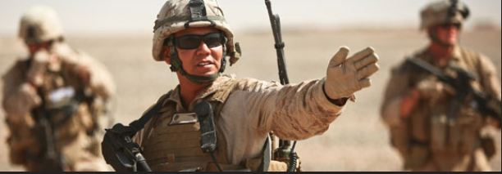
ELIGIBLE:
Current, *separated and retired members of the Army, Air Force, Navy, Marine Corps, Coast Guard, Reserve components and National Guard.
**For participants requesting a stipend or bonus, additional conditions apply.
Requirements vary, but program application within 3 years after retirement or separation from service is required for many members.
* With honorable discharge
**Those who meet certain education, military service and application requirements may also be eligible for Troops To Teachers’ financial assistance of up to 10K to support their transition to the classroom. Requirements vary, but program application within 3 years after retirement or separation from service is required.
Ruth Ploeger IMCOM Europe School Liaison Officer ruth.c.ploeger.naf@mail.mil DSN 314-544-9375

Slide 26



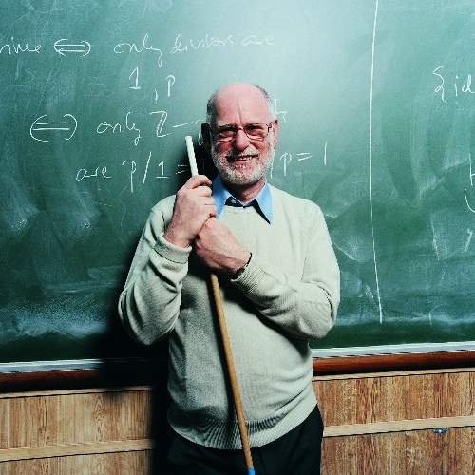
TTT Benefits
Counseling
Financial Assistance
Employment Facilitation
Mentorship
(in-development)
Ruth Ploeger IMCOM Europe School Liaison Officer ruth.c.ploeger.naf@mail.mil DSN 314-544-9375

Slide 27

Public, charter, Bureau of Indian Affairs schools:
An eligible school at least 30% of students are eligible for free/reduced lunch. These schools are eligible for the participant to receive a $5K bonus.
A high need school elementary or middle school in which at least 50% of students are eligible for free/reduced lunch or a high school where at least 40% of students are eligible for free/reduced lunch.
MAXIMUM financial support 10K TOTAL
*Stipend – living expenses up to 5K (*Post 9/11 GI participants not eligible)
Bonus – up to 10 K for teaching in high need school
Ruth Ploeger IMCOM Europe School Liaison Officer ruth.c.ploeger.naf@mail.mil DSN 314-544-9375

Slide 28


Resources for future teachers
www.dodea.edu/offices/hr/employment/
State Education Resources: www.schoolquest.org/state-education-resources
PRAXIS Tests www.ets.org/praxis/about
US Department of Education www.ed.gov
Individuals with Disabilities Education Act (IDEA) sites.ed.gov/idea
Teacher Certification Requirements by state iseducational.com/teacher-certification-requirements-by-state
Association of American Educators www.aaeteachers.org
CLEP Exams clep.collegeboard.org
Ruth Ploeger IMCOM Europe School Liaison Officer ruth.c.ploeger.naf@mail.mil DSN 314-544-9375

Slide 29
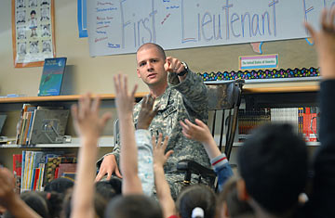
QUESTIONS
Ruth Ploeger IMCOM Europe School Liaison Officer ruth.c.ploeger.naf@mail.mil DSN 314-544-9375

